Slide 1
Deep learning
Azran Adi & Bercovich Yuval
Academic college of Tel Aviv Yaffo
March 2018

Slide 2
Agenda
The problem at hands and why to go to deep learning
Baseline – Naïve, non deep learning approach
Naïve deep learning approach
Better solutions
summary

Slide 3
Evolution of fraud
Companies demand information from the users in order to access to its services.
Companies make an effort to ensure that the information gained from user is not fabricated: the email address is valid, the address makes sense, etc.
Companies checks if a single value is an outlier in its “velocity” of hitting their systems.
Companies “waste time” by targeting specific attacks/
Fraudsters want to fraudulently gain access to such services.
Fraudsters write scripts that generates valid information, and send it to the companies.
Fraudsters change the scripts to randomly generate acceptable values.

Slide 4
Description of Acceptable solution
Identify randomly generated strings with high precision and recall.
Solution must be simple enough to be implemented in NRT solution
Solution should require as little IO actions as possible

Slide 5
Examples
Address:
Jabotinsky vs. dsjasdneh
MAC Address:
3C:D9:2B:DC:CA:F1 vs 3C:DD:FF:DC:CA:F1
Device name:
Joe’s Iphone vs jgdyem’s Iphone
Wifi Name:
BEZEQINT-2AC9 vs dearfd-234fed

Slide 6
This work
Where did we take this list?
We are going to work on street names in the US.
We got the information from XXXXX
We generated the randomized inputs (bad sample) by:
For each good sample, generate a string in the same length
The alphabet is A-Z, a-z, 0-9 and specific whitespaces and puntiuation

Slide 7
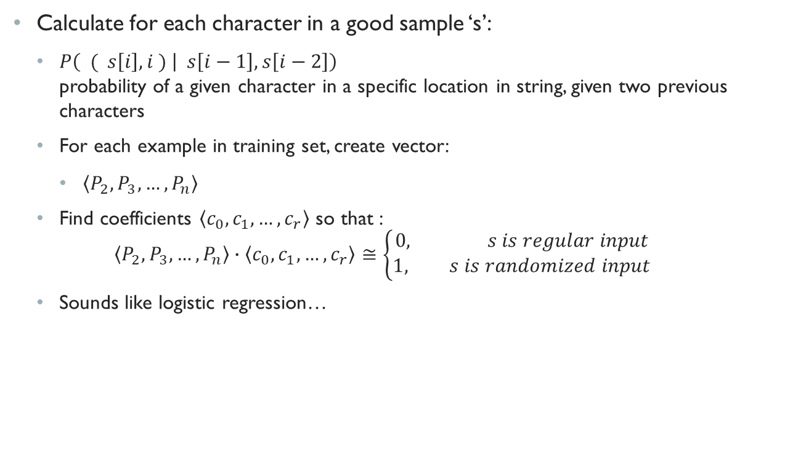
Basic Naïve solution
Calculate for each character in a good sample ‘s’:
$P\left( ( s\left[i\right], i ) | s\left[i−1\right],s\left[i−2\right]\right)$ probability of a given character in a specific location in string, given two previous characters
For each example in training set, create vector:
$\left\langle P_{2},P_{3},…,P_{n}\right\rangle$
Find coefficients $\left\langle c_{0},c_{1},…,c_{r}\right\rangle$ so that : $\left\langle P_{2},P_{3},…,P_{n}\right\rangle ∙\left\langle c_{0},c_{1},…,c_{r}\right\rangle ≅\left\{\begin{aligned}0, s is regular input \\ &1, s is randomized input\end{aligned}\right.$
Sounds like logistic regression…

Slide 8
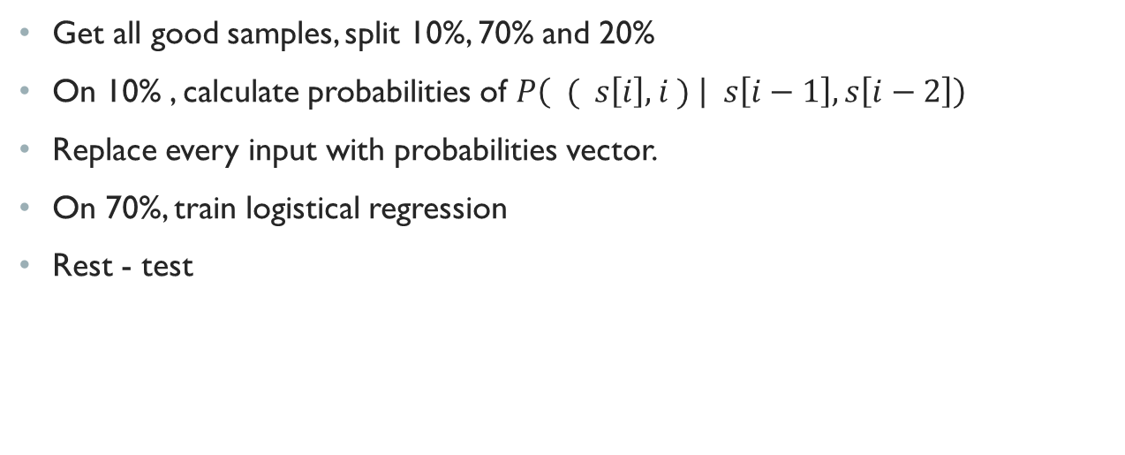
Data preperation
Get all good samples, split 10%, 70% and 20%
On 10% , calculate probabilities of $P\left( ( s\left[i\right], i ) | s\left[i−1\right],s\left[i−2\right]\right)$
Replace every input with probabilities vector.
On 70%, train logistical regression
Rest - test

Slide 9
performance

Slide 10
Pros and Cons
Pros
Cons
Easy to explain and repeat
Good domain knowledge can get better solution
Good Performance
Requires a lot of IO operations (Lookups)
Difficult to implement in NRT solutions

Slide 11
Basic Deep Learning
Idea:
User DNN to infer dependencies between characters
Simple implementation:
Translate any letter in alphabet to a number – for example asci code
Problems? A lot…
ASCII code does not infer magnitude, only order – ‘b’ is not twice as strong as ‘a’
‘A’ and ‘a’ have different values (64 vs 97)

Slide 12
Enhancement I
Instead of ASCII code or other mapping, use statistical importance:
For each letter in the alphabet, calculate its percentage from the total appearences of all characters
Instead of string ‘Steven’, use array: [0.002, 0.001, 0.035, 0.0001, 0.035, 0.004]
Infers strength

Slide 13
Model of DNN
Each word is cut or padded to 21 letters
Every word is transformed to float array
Each item in array is percentage of character appearences in population
Model has 3 fully connected layers:
Input is 21 neurons
2 Hidden layers with 20 neurons
Output is 2
Optimizer is SGD, with Mean Squared Error as loss function

Slide 14
Enhancement II
Although the problem seems to be categorical, we can “convert” it to a continues problem:
Instead of categorizing data points to 1 or 0
Give a number of how similar we are to 0 or 1
Now we can set the cut off point ourself (and not just using argmax or if score > 0.5
Convert the network to:
Model has 3 fully connected layers:
Input is 21 neurons
2 Hidden layers with 20 neurons
Output is 1 neuron

Slide 15
Performance
This should be a graph…
cutoff: 0.1 PR: 0.84121205726144 RE: 0.9922006264390466 AC: 0.9024559729511087
cutoff: 0.2 PR: 0.8955130868300789 RE: 0.9836545043456616 AC: 0.9344417017569333
cutoff: 0.3 PR: 0.9226647300135434 RE: 0.975066896222697 AC: 0.9466697089755025
cutoff: 0.4 PR: 0.9393437657748612 RE: 0.964985791034869 AC: 0.9513368873032007
cutoff: 0.5 PR: 0.951789006981996 RE: 0.9529340994420129 AC: 0.9523325520131096
cutoff: 0.6 PR: 0.9624417143952136 RE: 0.9376464975419527 AC: 0.9505279097263997
cutoff: 0.7 PR: 0.9714040983066482 RE: 0.9174428011367172 AC: 0.9452176979402186
cutoff: 0.8 PR: 0.9790261140942678 RE: 0.8849799829907279 AC: 0.9330104337364392
cutoff: 0.9 PR: 0.9861890916382595 RE: 0.8161339169034828 AC: 0.9023522578771599

